Slide 1

MACHINE LEARNING
Data-Driven HR: Anticipating Job Transitions among Data Science Trainees
Group 4A

Slide 2

CONTENTS
01
INTRODUCTION
02
DATA SUMMARY
03
DATA PRE-PROCESSING
04
DATA ANALYSIS
05
CONCLUSION & BUSINESS INSIGHTS

Slide 3

Data joke of the day
Why did the database administrator leave his job?
Because he couldn't handle too many relationships!

Slide 4
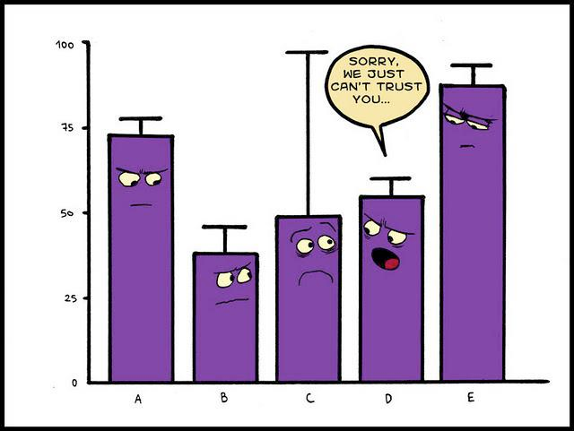
Why we choose?
Relevance
Real-world data

Slide 5
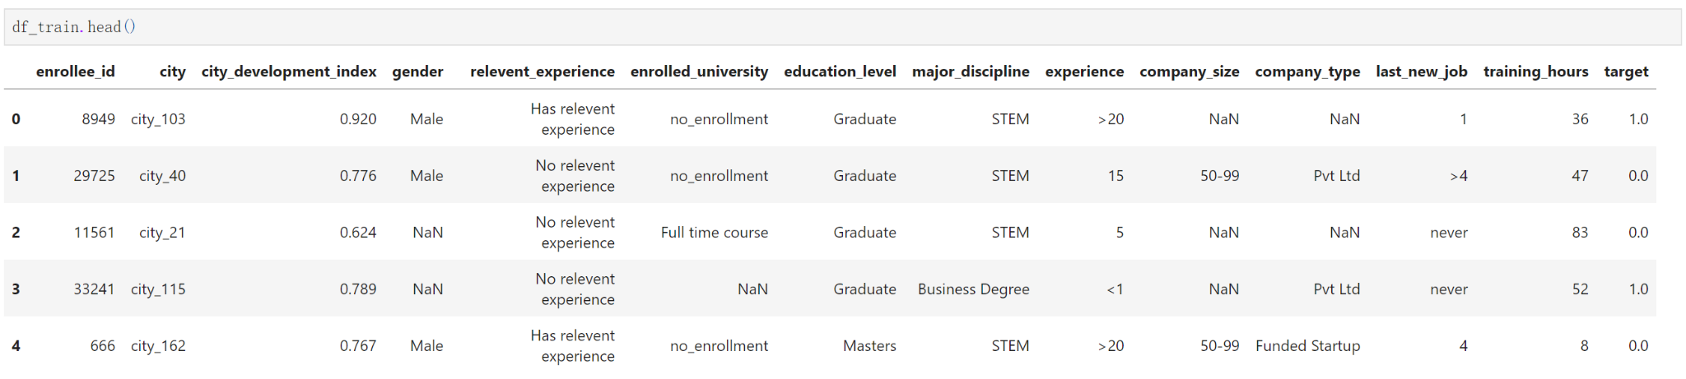
DATA SUMMARY
experience
company_size
company_type
last_new_job
training_hours
city_ development _index
gender
relevent_experience
enrolled_university
education_level
major_discipline
Target:
0 – Not looking for job change
1 – Looking for a job change

Slide 6
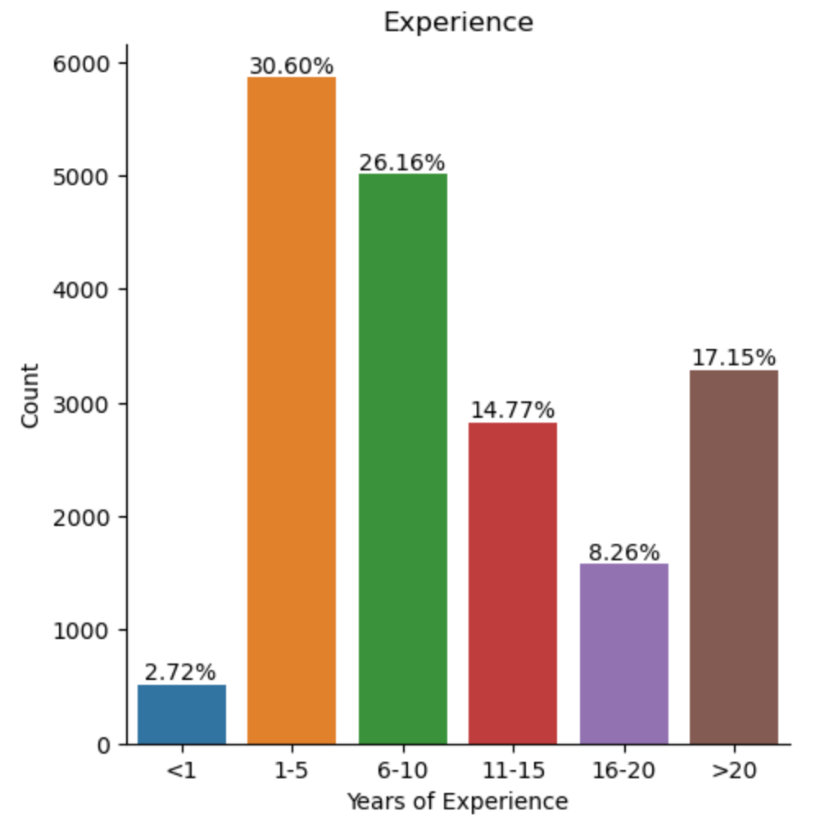
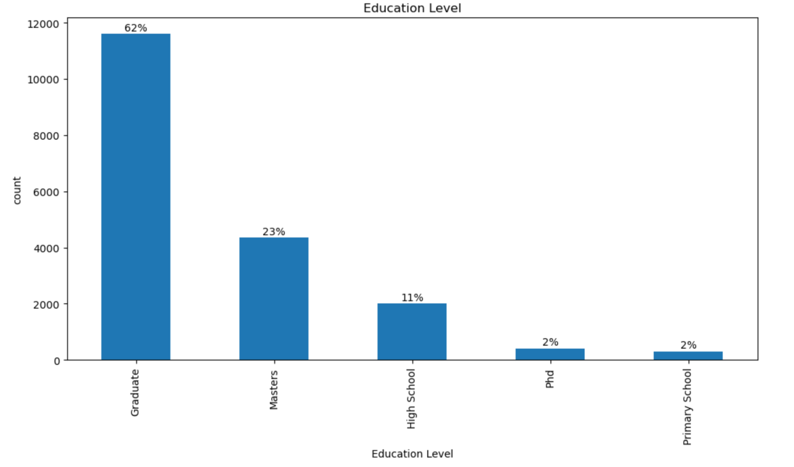
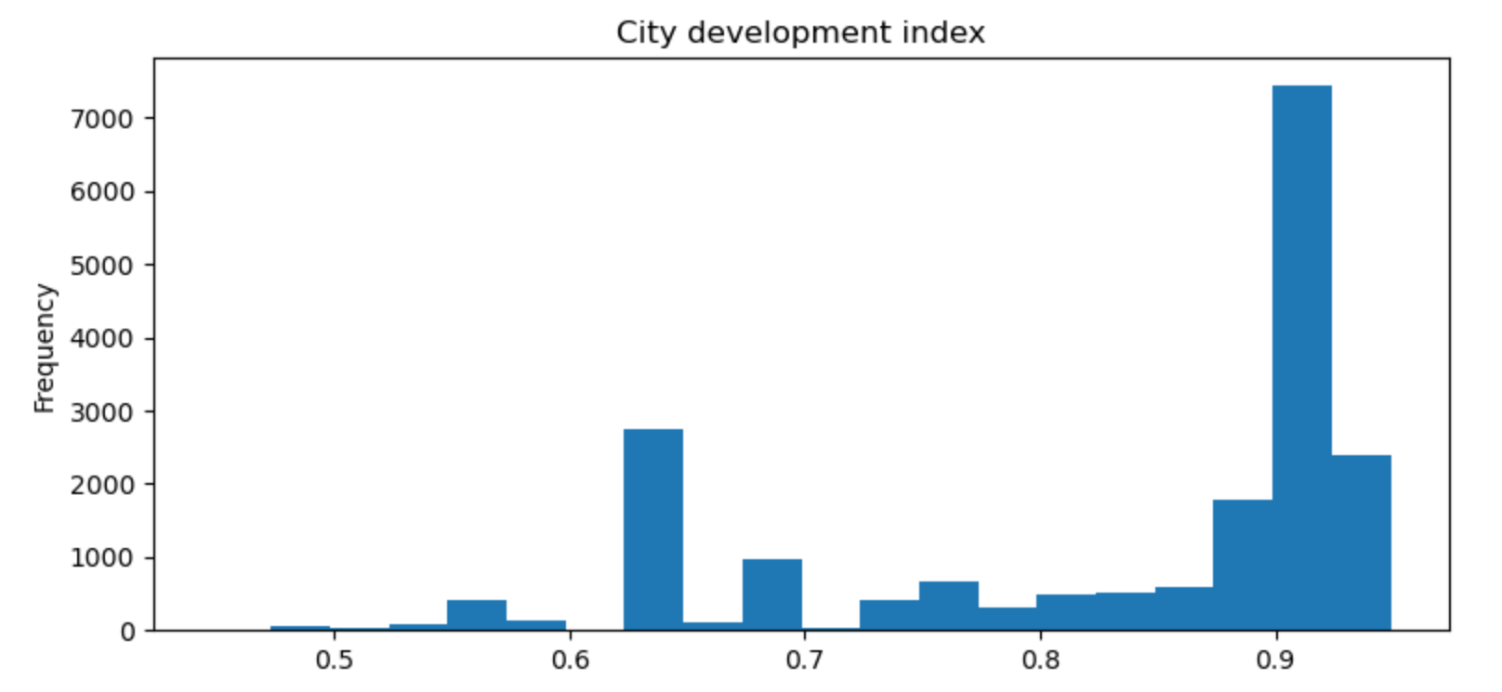
personal
factors
environmental
factors
Notes:
The train data contains 19155 rows and 14 columns. The test data contains 2129 rows and 13 columns.
The dataset contains 90% males and 8% females, while 1% identified as other.
This graph is the representation of the number of people who have relevant data scientist experience. About 71.99% of them have some sort of data scientist work experience, while 28.01% do not.

Slide 7
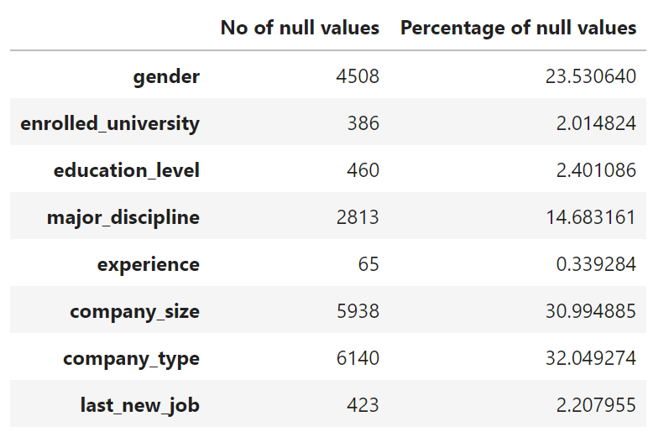
DATA PREPROCESSING
Handling Missing Variables
Benchmark -Without handling missing values
Dropped null values.
Dropping rows with null values is not a feasible option (46% of total rows).
Dropped columns which have less data correlation.
Filled up missing values with mean.
Filled up missing values with random variables.
large portion of missing values

Slide 8
Benchmark-Without Handling Missing Variables
 | ACCURACY | PRECISION SCORE | F1 SCORE
KNN | 74 | 16 | 23
LOGISTIC REGRESSION | 76 | 25 | 34
DECISION TREE | 80 | 64 | 62
RANDOM FOREST | 78 | 44 | 50

Slide 9
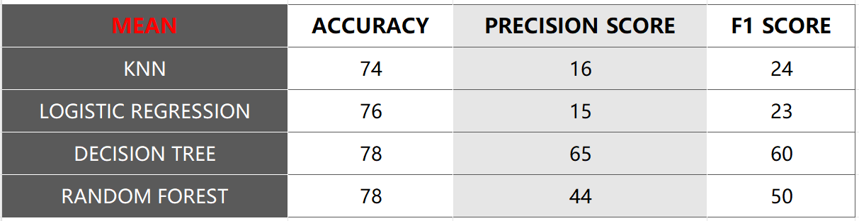
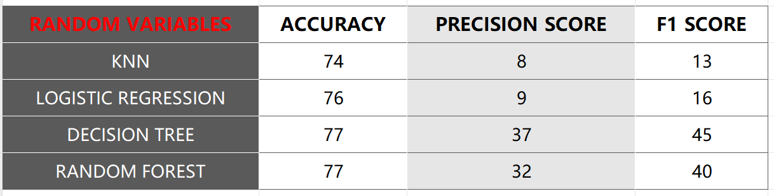
Handling Missing Variables
BEFORE SMOTE

Slide 10
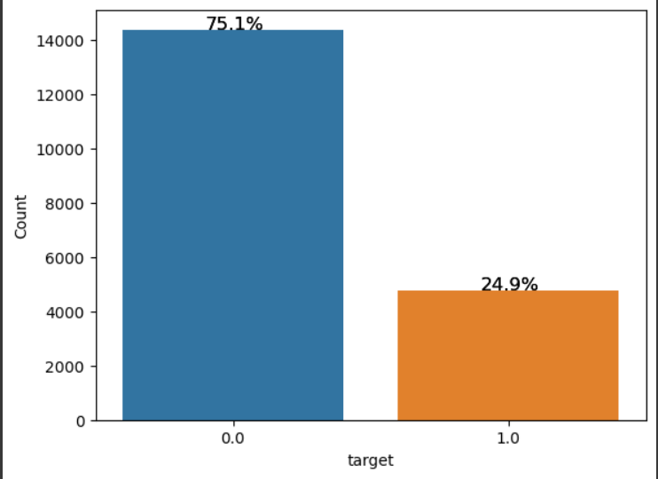
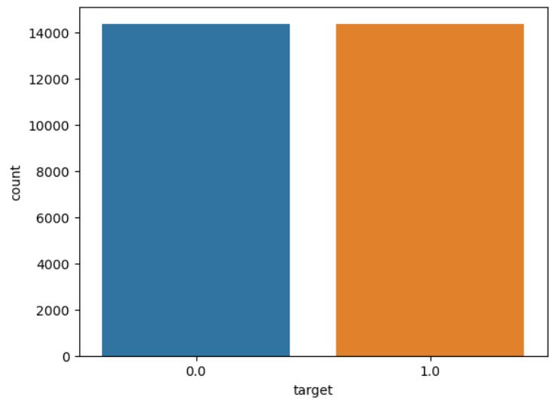
DATA PREPROCESSING
Imbalanced data with uneven class distribution
SMOTE technique
Before
After

Slide 11
DATA ANALYSIS
01
02
03
04
KNN
Logistic Regression
Decision tree
Random forest
Accuracy score
Precision score
F1 score
0.77
0.81
0.78
0.72
0.72
0.73
0.77
0.79
0.77
0.82
0.82
0.82

Slide 12

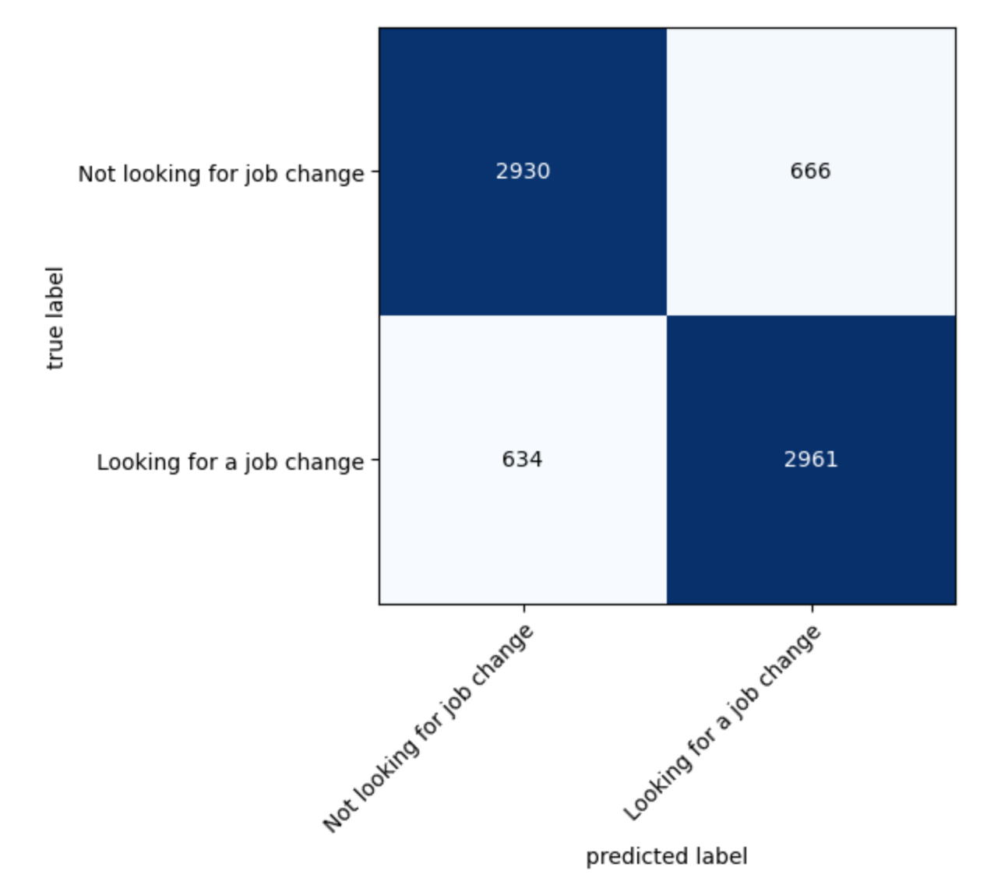

FN: Predicting a Person Is NOT Looking for a Job Change, but Actually are
FP: Predicting a Person who Is Looking for a Job Change, but Actually Not
TN
FP
82%
FN
TP

Slide 13
Talent Loss
Losing Valuable Employees
Loss of Specialized Knowledge
FN: Cost of Predicting a Person Is NOT Looking for a Job Change, but Actually are
Replacement Costs
Recruitment and Onboarding Costs
Future Impact
Skills Gap
Succession Planning

Slide 14
FP: Cost of Predicting a Person who Is Looking for a Job Change, but Actually Not
1
2
3
Wasted Resources
Quality of Training
Impact on Future Hiring
Training Costs
Time and Effort
Recruitment Costs
make poor decisions
lower morale among existing one
Mismatched Training Programs

Slide 15

BUSINESS INSIGHTS
improve the accuracy of prediction model
Continuous Model Evaluation
gain insights into job satisfaction and corroborate the accuracy of models
Collect and Incorporate Employee Feedback
Mitigation
allows the company to make more informed decisions
Implement Secondary screening process

Slide 16
THANK YOU
Group 4A

